Slide 1
Section 12.4
Matrix Algebra
Copyright © 2012 Pearson Education, Inc. Publishing as Prentice Hall.

Slide 2
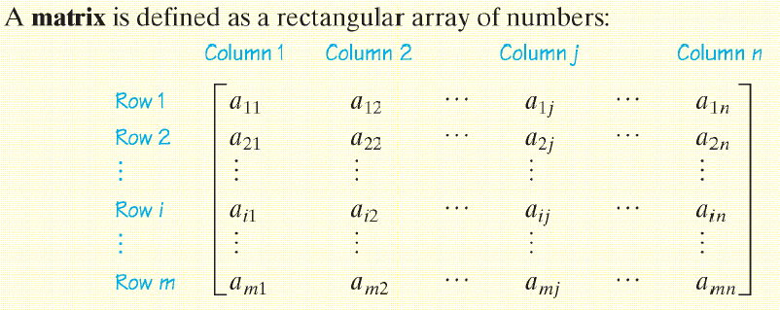
Copyright © 2012 Pearson Education, Inc. Publishing as Prentice Hall.

Slide 3


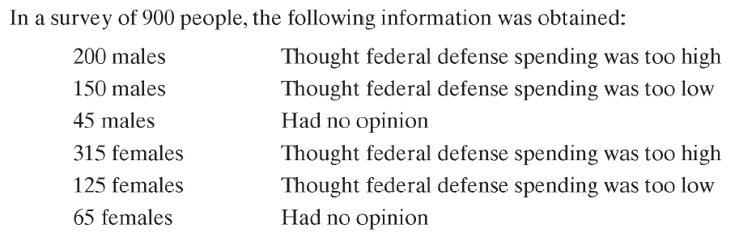
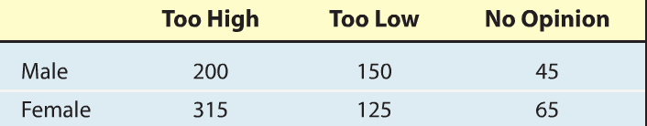
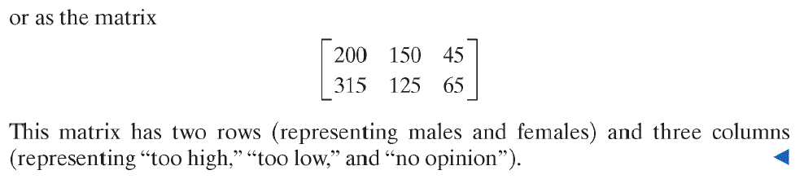
Copyright © 2012 Pearson Education, Inc. Publishing as Prentice Hall.

Slide 4



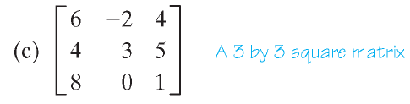
Copyright © 2012 Pearson Education, Inc. Publishing as Prentice Hall.

Slide 5
Copyright © 2012 Pearson Education, Inc. Publishing as Prentice Hall.

Slide 6

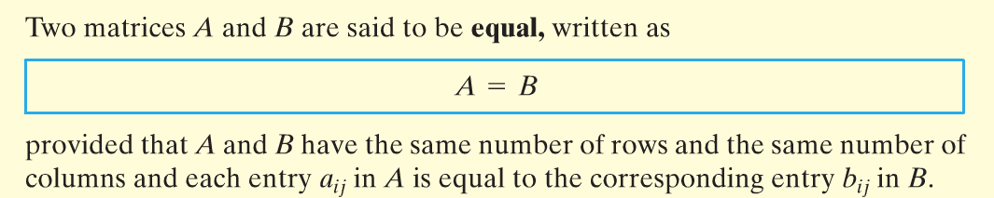
Copyright © 2012 Pearson Education, Inc. Publishing as Prentice Hall.

Slide 7
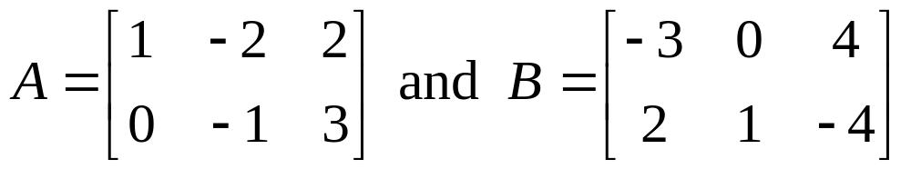
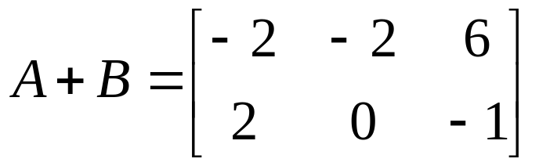
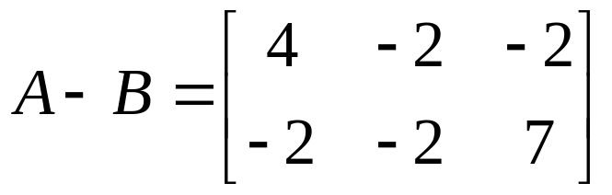
If A and B are both m × n matrices then the sum of A and B, denoted A + B, is a matrix obtained by adding corresponding entries of A and B. The difference of A and B, denoted A – B, is obtained by subtracting corresponding entries of A and B.
Copyright © 2012 Pearson Education, Inc. Publishing as Prentice Hall.

Slide 8
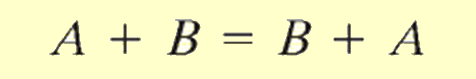
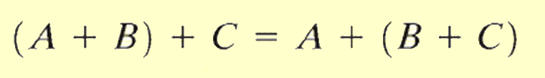
Copyright © 2012 Pearson Education, Inc. Publishing as Prentice Hall.

Slide 9
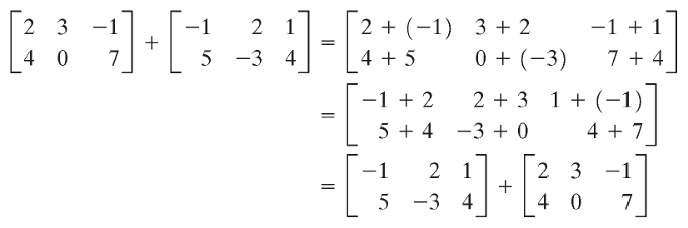
Copyright © 2012 Pearson Education, Inc. Publishing as Prentice Hall.

Slide 10

The Zero Matrix
Copyright © 2012 Pearson Education, Inc. Publishing as Prentice Hall.

Slide 11
Copyright © 2012 Pearson Education, Inc. Publishing as Prentice Hall.

Slide 12
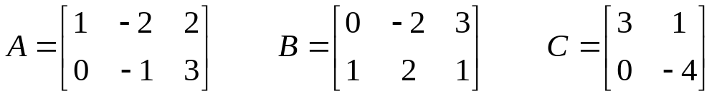

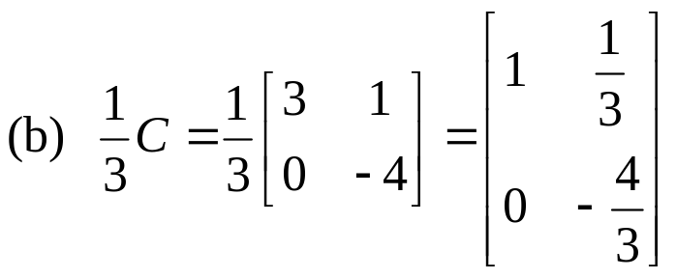
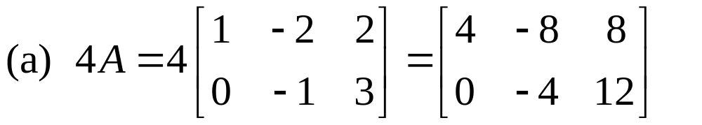
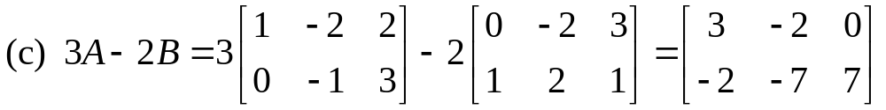
If A is an m × n matrix and s is a scalar, then we let kA denote the matrix obtained by multiplying every element of A by k. This procedure is called scalar multiplication.
Copyright © 2012 Pearson Education, Inc. Publishing as Prentice Hall.

Slide 13
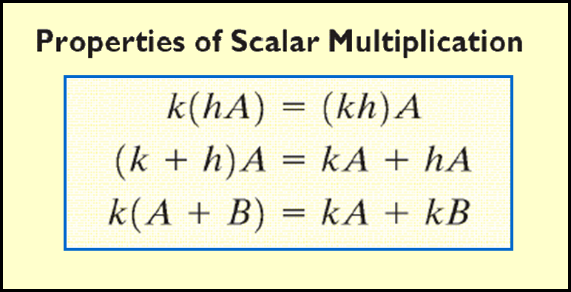
Copyright © 2012 Pearson Education, Inc. Publishing as Prentice Hall.

Slide 14

Copyright © 2012 Pearson Education, Inc. Publishing as Prentice Hall.

Slide 15
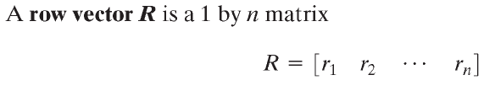
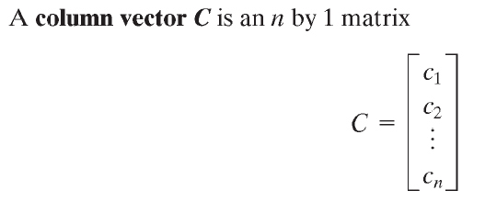
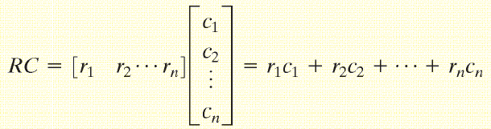
Copyright © 2012 Pearson Education, Inc. Publishing as Prentice Hall.

Slide 16
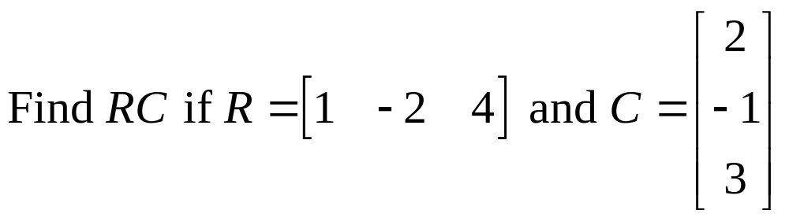
Copyright © 2012 Pearson Education, Inc. Publishing as Prentice Hall.

Slide 17
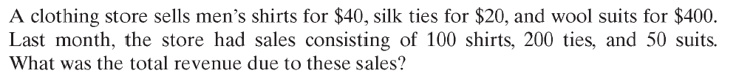
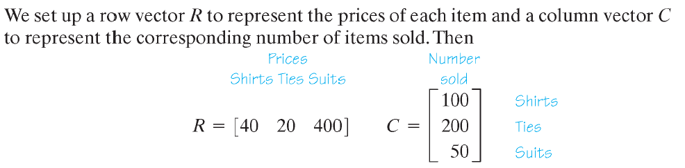
Copyright © 2012 Pearson Education, Inc. Publishing as Prentice Hall.

Slide 18
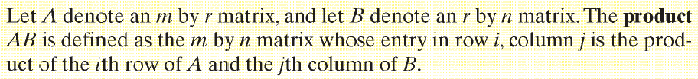
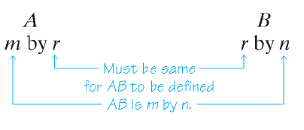
Copyright © 2012 Pearson Education, Inc. Publishing as Prentice Hall.

Slide 19

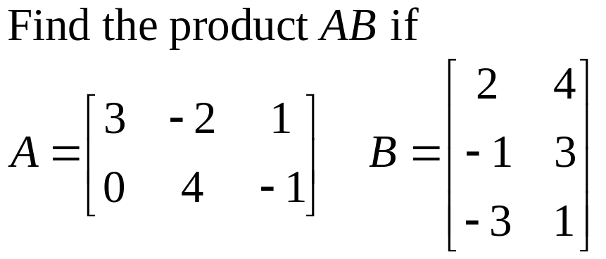
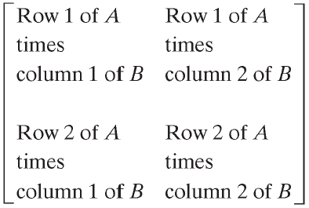
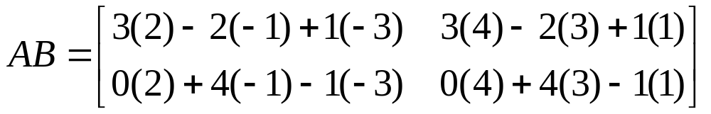
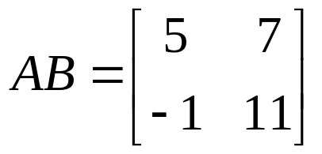
Copyright © 2012 Pearson Education, Inc. Publishing as Prentice Hall.

Slide 20
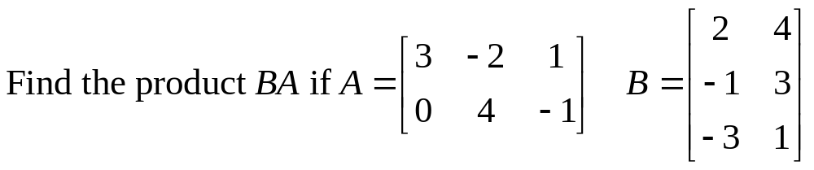
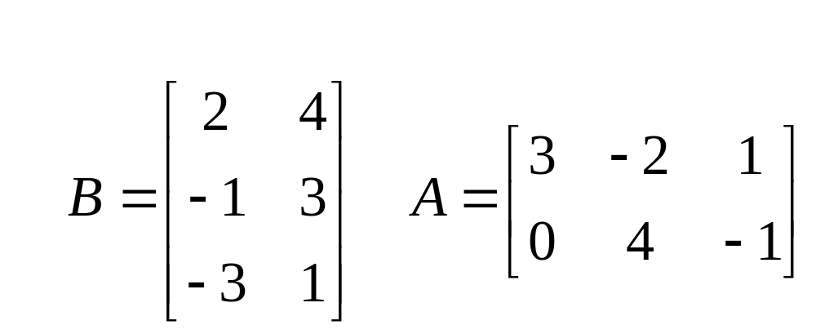
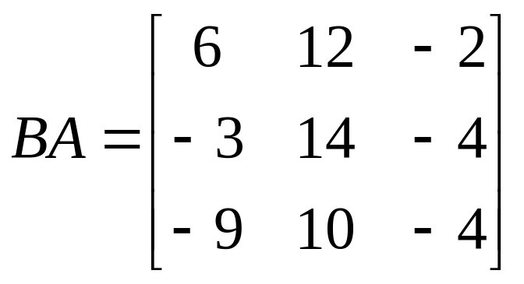
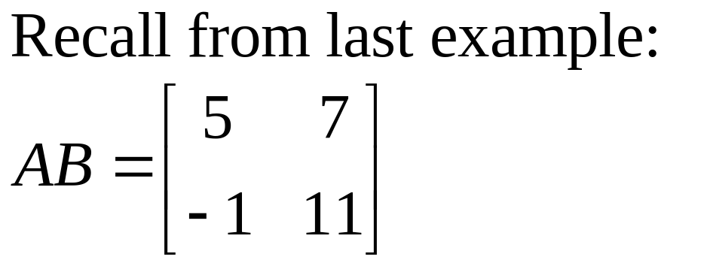
Copyright © 2012 Pearson Education, Inc. Publishing as Prentice Hall.

Slide 21
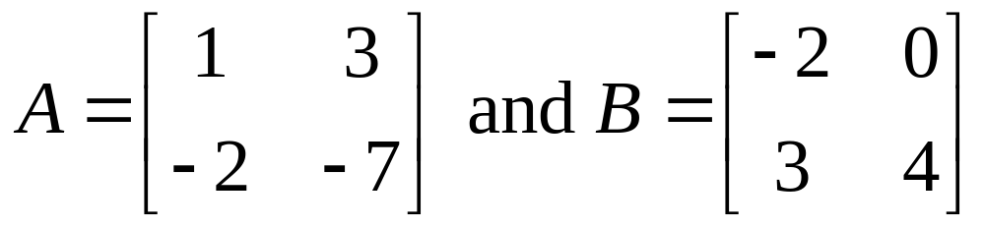

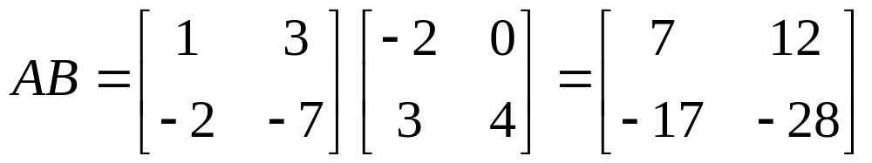
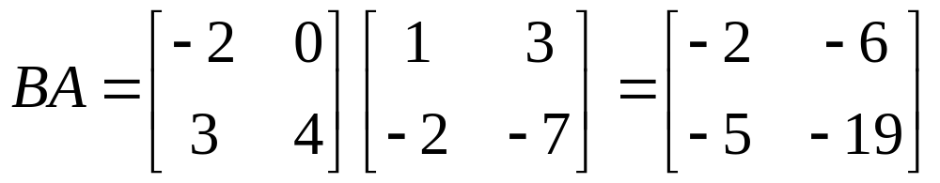
AB ≠ BA
Copyright © 2012 Pearson Education, Inc. Publishing as Prentice Hall.

Slide 22




Copyright © 2012 Pearson Education, Inc. Publishing as Prentice Hall.

Slide 23
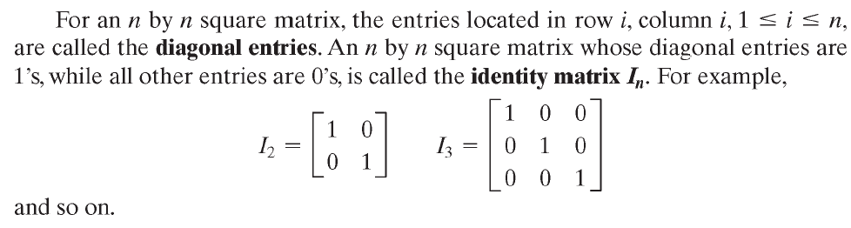
Copyright © 2012 Pearson Education, Inc. Publishing as Prentice Hall.

Slide 24
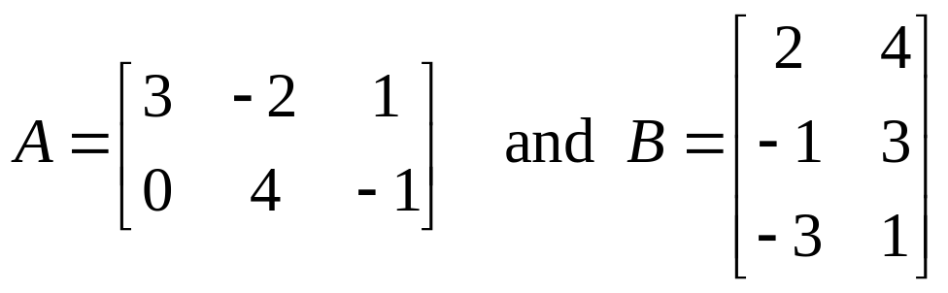
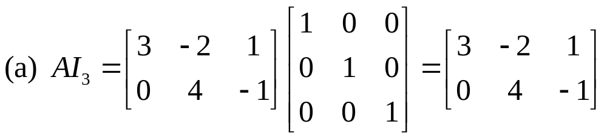
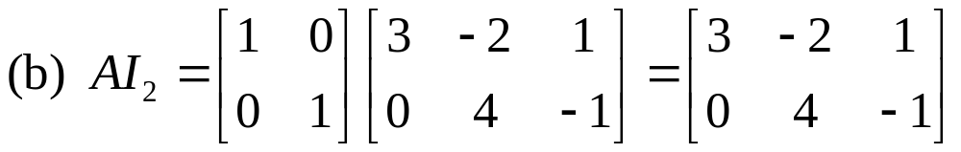
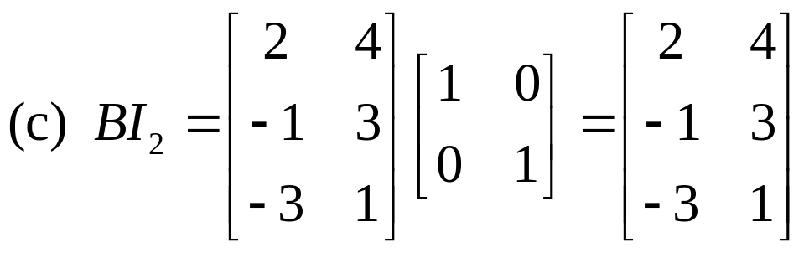
Copyright © 2012 Pearson Education, Inc. Publishing as Prentice Hall.

Slide 25
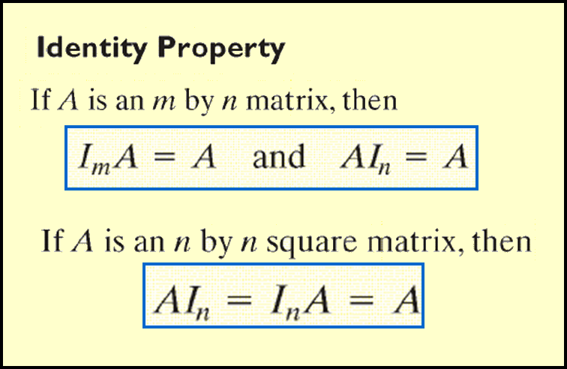
Copyright © 2012 Pearson Education, Inc. Publishing as Prentice Hall.

Slide 26
Copyright © 2012 Pearson Education, Inc. Publishing as Prentice Hall.

Slide 27

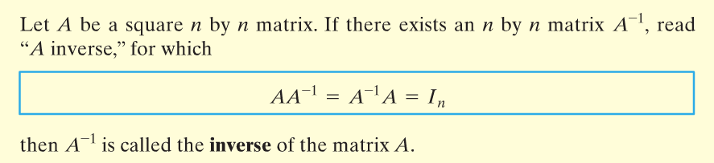
Copyright © 2012 Pearson Education, Inc. Publishing as Prentice Hall.

Slide 28
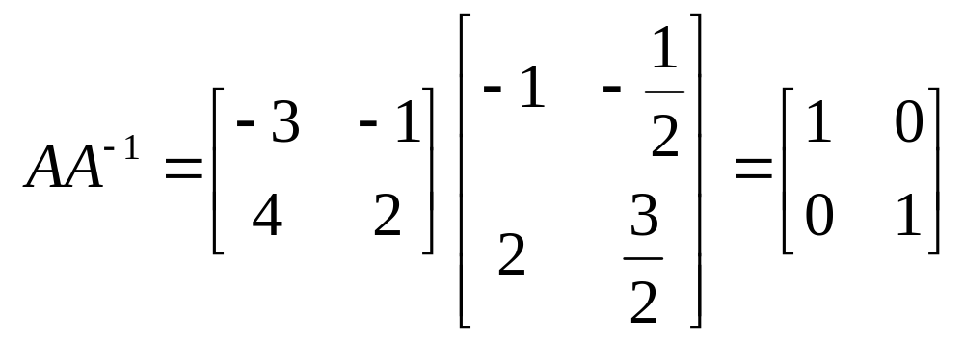
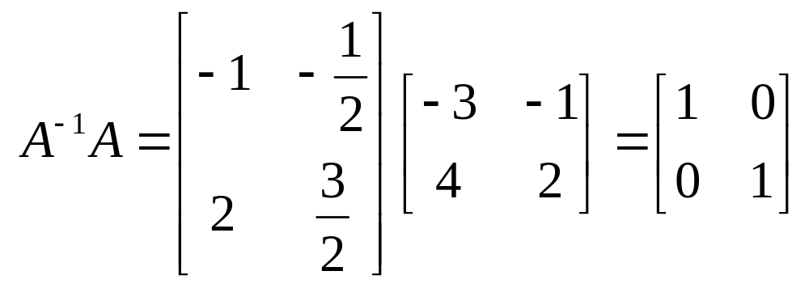
Copyright © 2012 Pearson Education, Inc. Publishing as Prentice Hall.

Slide 29
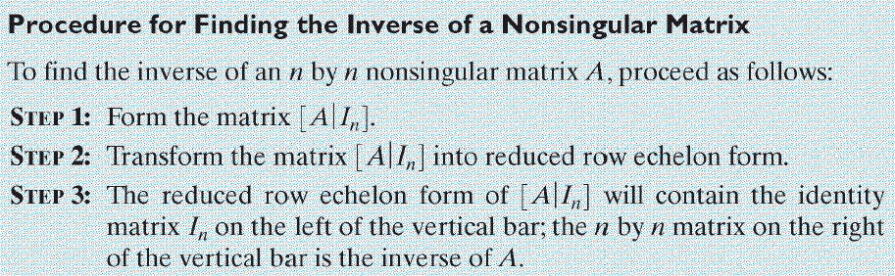
Copyright © 2012 Pearson Education, Inc. Publishing as Prentice Hall.

Slide 30

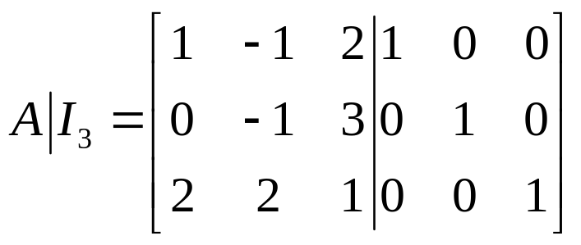
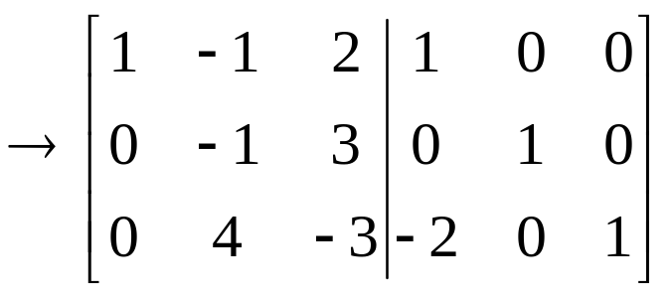
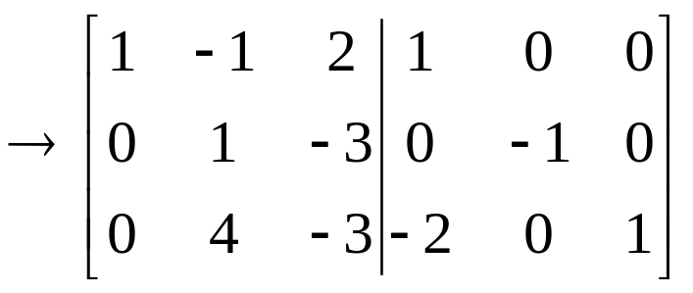
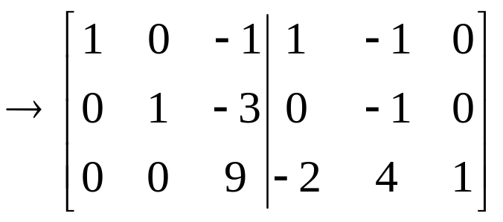



R₃= –2r₁+ r₃
R₁= r₁+ r₂
R₃= – 4r₂+ r₃
R₂= –r₂
R₃= 1/9r₃
R₁= r₁ + r₃
R₂= 3r₃ + r₂

Slide 31




R₁ = –1/2r₁
R₂ = – 4r₁ + r₂
We can see that we cannot get the identity on the left side of the vertical bar. We conclude that A is singular and has no inverse.
Copyright © 2012 Pearson Education, Inc. Publishing as Prentice Hall.

Slide 32
Copyright © 2012 Pearson Education, Inc. Publishing as Prentice Hall.

Slide 33



Copyright © 2012 Pearson Education, Inc. Publishing as Prentice Hall.

